Slide 1


Pune Vidhyarthi Griha’s College of Engineering & Technology Department of Information Technology
College Logo
Project Based Seminar (Oral) Presentation
On
Creating a Decentralized Social Network Using Blockchain
By
TE IT Group No 14
Guide
Prof. D. T Varpe
14th June 2021

Slide 2
Contents
Project Motivation
Project Details and Problem Statement
Project Aims and Objectives
Decentralized Social Networks
Blockchain and Cryptocurrency
Consensus Algorithms
Smart Contracts
Conclusions
References

Slide 3
Project Motivation
Decentralized Social Networks are being considered as an alternative for the existing social platforms
Blockchain is at the heart of Cryptocurrency and Decentralized Social Networks
The underlying Consensus algorithm determines how the system will behave and the performance it can achieve.
“Smart contracts” are a way of using computers to make contracts unbreakable, where contracting parties do not need to trust one another to perform or rely upon intermediaries. Performance is guaranteed.
Notes:
Lately, people all over the world have been expressing privacy concerns while using the current social media, such as Facebook, WhatsApp, Instagram. This made people consider, is there any other choice? Are there any alternativess? So, decentralized social networks is one great alternative to consider. 2) Blockchain is the technology that is generally used to implement DSNs and cryptocurrencies, hence it becomes important to understand, “What is Blockchain”.
3) Blockchain systems have consensus algorithms in them, which determine how the system will behave. Hence we analyze some of the major consensus algorithms in our project
4) Smart Contracts ensure the reliability and performance of the system, which makes it ideal for secure software development

Slide 4
Project Details
Project Title : Creating a Decentralized Social Network Using Blockchain
Project Domain: Artificial Intelligence / Blockchain
Project Group Members:
T150078536 - Yatish Kelkar
T150078550 - Mahesh Nahak
T150078537 - Gaurav Khairnar
T150078507 - Kshitij Chitnis

Slide 5
Problem statement
Creating a Decentralized Social Network using Blockchain

Slide 6
Aim and Objectives of the Project
The aim of this project is…
To Create a Decentralized Social Network using Blockchain
Project objectives:
1. To understand the need for Decentralized Social Networks
2. To understand what are Decentralized Autonomous Organizations
3. To understand the inner working of Blockchain technology
4. To understand the concept of Cryptocurrency and its correlation with Blockchain
5. To understand the working of 2 major Consensus algorithms in Blockchain systems
6. To understand the working and use cases of Smart Contracts
7. To understand how developing secure and modular Smart Contracts can be made easy with the Substrate framework.

Slide 7
Project and Seminar Topics
Creating a Decentralized Social Network using Blockchain
Mahesh Nahak: Creating a Decentralized Social Network
Yatish Kelkar: An in-depth overview of Blockchain and its Applications in Cryptocurrency
Gaurav Khairnar: Understanding Consensus algorithms in Blockchain-based applications
Kshitij Chitnis - The role of Smart Contracts in Secure Software Development

Slide 8
PART 1
Creating a Decentralized Social Network
Mahesh Nahak

Slide 9
Introduction
Online Social Networks (OSNs) have become popular in the last 2 decades
Privacy is one of the main concerns users have while using these platforms
User data for marketing purposes, without the complete consent of users
Data Security is also an important responsibility of OSNs, however data leaks are on a rise
This gives rise to the “Decentralized Social Networks”
Notes:
t many believe these changes aren’t necessarily positive. In recent years, many social networks have caught the attention of internet activists, which brought to light the privacy-invasive model of these social networks. They can fully grasp all users’ information, and in the meanwhile, users can only trust them for protecting their private information. However, it was revealed that these networks use this data not only for marketing purposes, but there were trades of these data between corporations as well.

Slide 10
Seminar Motivation
More and more users are becoming conscious about privacy and data-security
Alternatives to existing social networking platforms are being explored
Decentralized Social Networks bring internet values like:
Enhanced privacy
Data security
Transparency
Incentivization
Open-source
Notes:
As more and more users around the world become conscious about the privacy and securityrelated concerns in social media platforms, alternatives to these platforms are being explored. The idea of Decentralized Social Networks is being favored by a community, which keeps increasing with every passing day, as more and more people become aware of and understand it. Decentralized social networks bring with them a wide number of internet values, such as enhanced privacy, security, transparency, incentivization, elimination of third parties, and opensource. These are some values we believe in, and feel are the need of the time, which made us choose this project.

Slide 11
Seminar Aims and Objectives
Aim: To study and understand Decentralized Social Networks, and their relevance in today’s world
Objectives:
To research the need for Decentralized Social Networks
To understand the services offered by Decentralized Social Networks
To understand what Decentralized Social Networks can be implemented with
To research about the existing Decentralized Social Networks
To understand what are Decentralized Autonomous Organizations (DAOs)

Slide 12
Literature Survey
Privacy of users is found to be easily compromised in OSNs
Cannot regulate OSNs direct access to user data or prevent them from providing data to third parties
Recent headlines:
Facebook Data Trading - 2018
Air India Data Breach - 2021
Dominos India Data Breach - 2021
Notes:
Lately, many research efforts have been devoted to the various functional aspects of OSNs, which make the OSN systems more and more convenient for users [4]. However, at the same time, the privacy of users is found to be easily compromised in OSNs. Although most OSNs allow users to adjust privacy settings to limit other users’ access, there are no good technical solutions to regulate OSN providers’ access or prevent them from providing data to third parties.
OSNs with central structures can fully grasp all users’ information, and in the meanwhile, users can only believe that the OSN providers can protect their private information. In this situation, users cannot even make sure that the OSN providers will actually delete their data when they choose to delete their information after destructing their accounts

Slide 13
Literature Survey
Senthil Kumar and Saravanakumar Kandasamy observed that privacy-protection endeavours are feeble by the social networking sites
Johanna Cabalhin pointed out that on many existing social networks, users are needed to reveal a certain detail about them online to prove they are who they claims to be
The more information a user shares, the easier it is to predict some of the user’s most private information using algorithms
Notes:
This has incited a long-running debate about whether this trade of data for a "personalized experienced" is moral or not.

Slide 14
Literature Survey/Related work
Sr. No. | Reference Name (Write Paper Title) | Seed Idea/ Work description | Problems found | Link
1 | On Privacy and Security in Social Media – A Comprehensive Study | An analysis on Information sharing on social media considering privacy and security aspects | Breach of information by the social platforms is a major concern | https://www.researchgate.net/publication/301234158_On_Privacy_and_Security_in_Social_Media_-_A_Comprehensive_Study
2 | Facebook User’s Data Security and Awareness: A Literature Review (Journal of Academic Research) | Users are becoming more aware about data security on social networking platforms. | Data mining through social networking sites makes personal information readily available | https://www.researchgate.net/publication/331408062_Facebook_User's_Data_Security_and_Awareness_A_Literature_Review
Minimum FIVE references should be there from literature.

Slide 15
Decentralized Social Networks
What are Decentralized Social Networks?
Decentralized social networks operate on independently run servers
Decentralized social networks give users more control and autonomy.
Network of multiple social websites, where users of each site communicate with users of any of the involved sites.
Allows creators in the platform to monetize their content
Marketing is possible, without sharing of data
Participants and stakeholders can contribute in shaping the direction of the network
Notes:
it isn’t a standalone website that you can access — it is a network of hundreds of different communities that each own an instance of the code. It allows the participants of the social network to be more in control of their data, and decide who gets access to what part of it. It also allows the participants who are creators of some kind, to monetize and earn tokens equivalent to major cryptocurrencies, and incentivize participants who assist the network in their own ways.

Slide 16
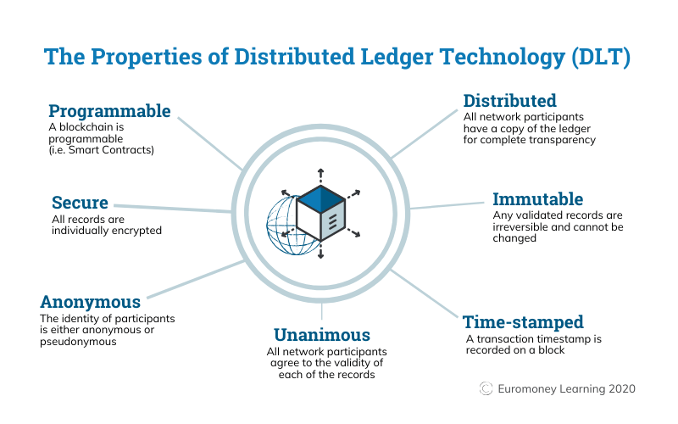
Blockchain-based Social Networks
Notes:
Blockchain is a system of recording information in a way that makes it difficult or impossible to change, hack, or cheat the system. [9,10] A blockchain is essentially a digital ledger of transactions that is duplicated and distributed across the entire network of computer systems on the blockchain

Slide 17
Benefits of Decentralized Social Networks
Users don’t have to put trust in centralized authorities
No single point of failure
Less censorship
More likely to be open development platforms
More meritocratic
Scope for Crowd-funding

Slide 18




Major Existing Decentralized Networks
Signal
Mastodon
Diaspora
Minds
Notes:
Unlike the end-to-end encrypted chats in WhatsApp, Signal doesn’t track you, share your data and invade your privacy. Mastodon isn’t a single website like Twitter, it’s a network of thousands of communities operated by different organizations and individuals that provide a seamless social media experience. Diaspora was one of the earliest decentralized social networks. This was back in 2010 and Diaspora was touted as a Facebook alternative On Minds, you can post videos, blogs, images and set statuses. You can also message and video chat securely with groups or directly with friends. Trending feeds and hashtags allows you to discover articles of your interest. You also have the option to earn tokens for your contributions. These tokens can be used to upgrade your channel. Creators can receive direct payments in USD, Bitcoin and Ether from fans.

Slide 19
Decentralized Autonomous Organizations (DAOs)
A form of Decentralized social networks
A form of venture capital fund, without a typical board of directors
Self-enforcing open-source protocol
Blockchains and smart contracts reduce transaction costs of management
Individual behavior is incentivized with a token to collectively contribute to a common goal.
Notes:
DAO: like a regular big corp, but autonomous, meaning less human intervention. DAOs run by a programming code written on a collection of smart contracts written on a Blockchain. So where do humans stand in this scenario?
DAOs can have stakeholders that can vote on changes. DAO Stakeholders own tokens or stakes in the company, and use these to vote. How they get tokens depends on the specific business model. In a perfect DAO, every investor gets an opportunity to shape the organization. Innovative ideas can be put forward by every investor which will be considered by the organization.

Slide 20
Conclusion
Decentralized Social Media Platforms still have a long way to go before they can compete with giants like Facebook, Twitter or Instagram. However, with an increase in privacy and security awareness, and the potential of Blockchain, Decentralized Social networks will surely occupy a large scene in the future of social media.

Slide 21
References
[1] Johanna P. Calbalhin, “Facebook User’s Data Security and Awareness: A Literature Review”, Journal of Academic Research, pp. 01-13, March 2018
[2] Senthil Kumar N, Saravanakumar K, Deepa K, “On Privacy and Security in Social Media – A Comprehensive Study , ScienceDirect, December 2015
[3] Min Xu, Xingtong Chen & Gang Kou, “ A Systematic review of Blockchain”, Springer Open, 5, Article number: 27 (July 2019)
[4] Carly Page, “Air India Data Breach: Hackers Access Personal Details Of 4.5 Million Customers”, https://www.forbes.com/sites/carlypage/2021/05/23/air-indiadata-breach-hackers-access-personal-details-of-45-million-customers/ , May 23 2021
[5] Sindhu Hariharan, “User info linked to 18 crore Domino’s orders leaked” , https://timesofindia.indiatimes.com/business/india-business/user-info-linked-to-18- crore-dominos-orders-leaked/articleshow/82898118.cms/ , May 24 2021
[6] Blockchainhub Berlin, “Tokenized Network: What is a DAO?” , https://blockchainhub.net/dao-decentralized-autonomous-organization/

Slide 22
PART 2
An in-depth overview of Blockchain and its application in Cryptocurrency
Yatish Kelkar

Slide 23
Seminar Motivation
Blockchain is fast replacing traditional methods of data storage
More and more companies and organizations are adopting blockchain into their workflows and work mechanisms.
Blockchain is at the heart of cryptocurrency and hence it becomes vital for us to understand it to ensure smooth working of our tool or product

Slide 24
Seminar Aims and Objectives
The aim of this seminar is : To study and understand Blockchain technology concept and it’s applications in Cryptocurrency
The objectives of this seminar include :
1. To research about the origins and conceptualization of Blockchain Technology
2. To understand the inner working of Blockchain technology
3. To take an overview of the cryptographic algorithms used in Blockchain technology
4. To understand the concept of cryptocurrency and its correlation with Blockchain

Slide 25
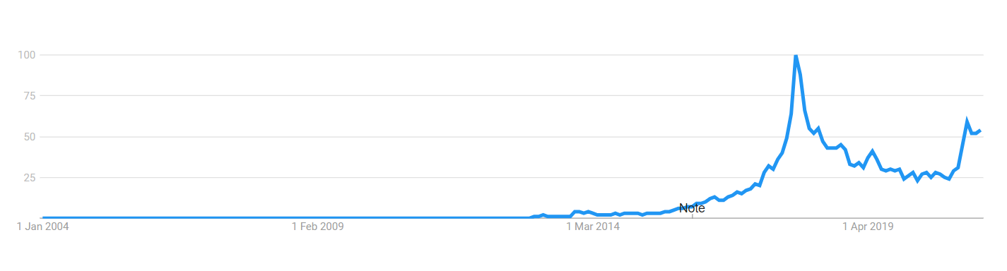
Introduction to Blockchain
Blockchain = Block + chain => a chain of blocks
Significant technological innovation, fastest growing technology

Slide 26
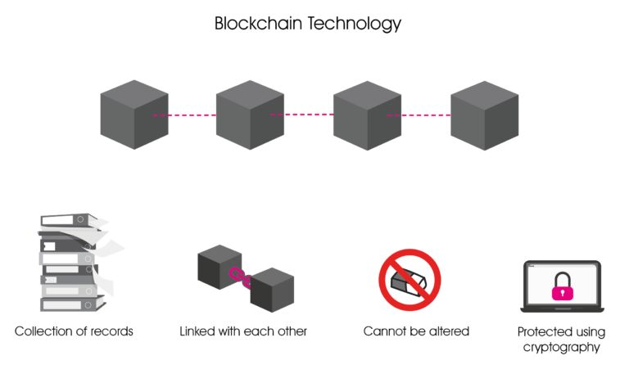
Introduction to Blockchain
Blockchain is a distributed ledger
A database that is shared between everyone

Slide 27
Literature Survey
Stuart Haber and W. Scott Stornetta : “How to time stamp a Digital Document” in 1991
Satoshi Nakamoto : “Bitcoin: A Peer-to-Peer Electronic Cash System in 2008 : Created the FIRST blockchain database
Actually created first for Bitcoin

Slide 28
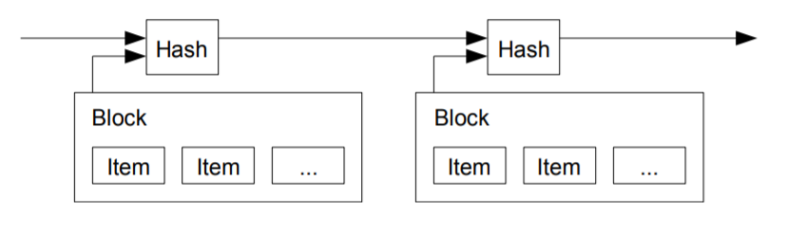
Nakamoto’s solution :
Storing data into blocks
Timestamping these blocks with a hash derived from data and hash of last block
3. Chaining all blocks such that each block stores the hash value of the previous block

Slide 29
4. Creating a hash that has a fixed number of 0s in the starting, which would require a lot of CPU power, so changing any information in the block will require redoing all the work
Block 1
h1
Block 2
h2
Block 3
h3
block 1 corrupted
Block 1
h1
Block 2
h2
Block 3
h3
block 2 corrupted
block 3 corrupted
Block 1
h1
Block 2
h2
Block 3
h3
all blocks corrupted

Slide 30
Literature Survey/Related work
Minimum FIVE references should be there from literature.
Sr. No. | Reference Name | Seed Idea/ Work description | Problems found | Link
1 | Bitcoin: a peer to peer electronic cash system | The core concept of blockchain and it’s initial implementation | Ignores some advanced ways of hacking blockchains | https://bitcoin.org/bitcoin.pdf
2 | The Literature Review of Blockchain Adoption | Explores the adoption and implementation of blockchain in various fields | - | https://doi.org/10.9734/ajrcos/2021/v7i230177

Slide 31
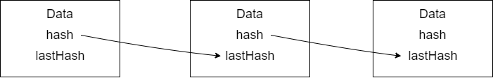
The Blockchain Structure
Modern blockchains are based on the model created by Nakamoto
Linked list structure
Each block is a node of the linked list
hash(n) = hashFunction(data(n) , hash(n-1), other properties)

Slide 32
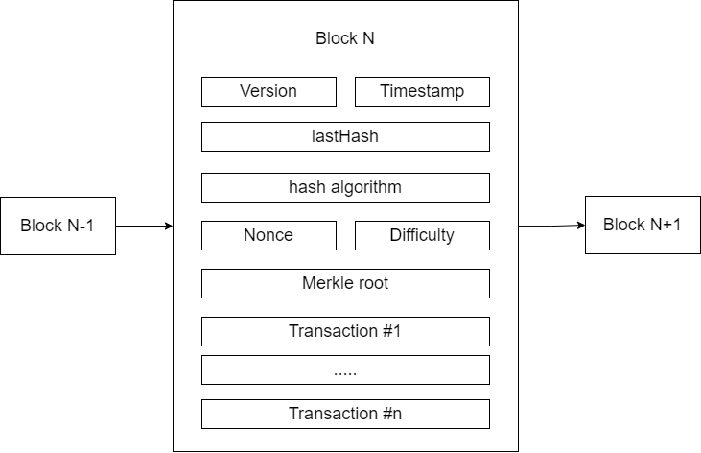
Structure of a block
difficulty and nonce
how much efforts required to create the hash
lastHash
timestamp
a list of transactions = data

Slide 33
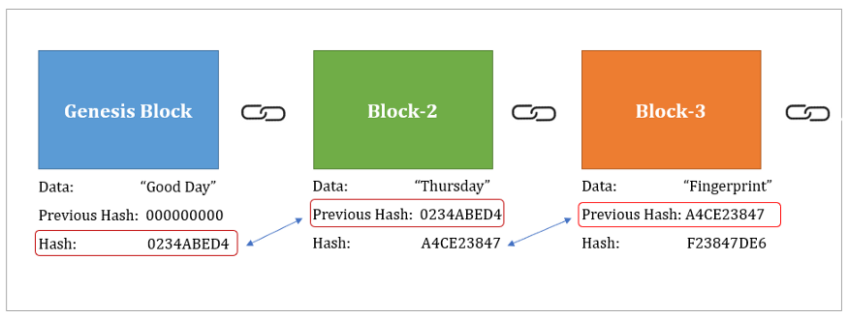
Genesis block
the first block of the blockchain
lastHash(0) = 0
ancestor of rest of the block in the blockchain
changing the genesis block -> whole blockchain becomes invalid ( corrupted )

Slide 34
Hashing
Unique fixed size value ( output ) obtained from some input
hash(n) = SHA256( data(n), hash(n-1), other metadata properties )
SHA256 Hashing algorithm:
produces a hash that is 256 bits long
usually represented as a hexadecimal string of length 64
most popular hashing algorithm
hasn't been cracked yet

Slide 35
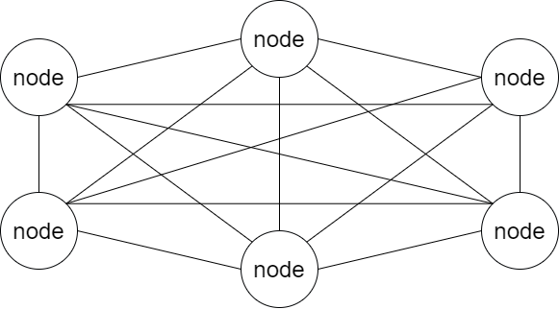
Peer to peer
Any node can communicate with any other node
Each node holds its own copy of the blockchain database
Whenever a new block is to be added to the blockchain, each node will check the new block and add it to it’s personal copy of the blockchain

Slide 36
Adding blocks to the blockchain
new block added
new block

Slide 37
Cryptocurrency
Digital money that is bought with real money
Bitcoin, Ethereum, Litecoin, Nexo
Value of the cryptocurrency can change at any time (volatile, fluctuates)
Creating currency -> mining/creating a block in the blockchain
People called ‘miners’ will create/mine this currency and will be paid some money for their efforts
Application of Cryptocurrency in our project :
1. Any transaction that takes place within our decentralized social network will take place through cryptocurrency
2. We plan to create our own currency temporarily called ‘BitRupee’

Slide 38
Conclusion
In this seminar we have discussed the structure, implementation and applications of blockchain technology.
We studied the application of blockchain in cryptocurrencies
We aim to apply this knowledge in the development of our project of creating a decentralized social network using blockchain.

Slide 39
References
Almekhlafi, S., & Al-Shaibany, N. (2021). The Literature Review of Blockchain Adoption. Asian Journal of Research in Computer Science, 7(2), 29-50. https://doi.org/10.9734/ajrcos/2021/v7i230177
Fauzi, Muhammad & Paiman, Norazha. (2020). Bitcoin and Cryptocurrency: Challenges, Opportunities and Future Works. Journal of Asian Finance Economics and Business. 7. 695-704. 10.13106/jafeb.2020.vol7.no8.695.
Nakamoto, S. (2008) Bitcoin: A Peer-to-Peer Electronic Cash System. https://bitcoin.org/bitcoin.pdf
Pournader M, et al. Blockchain applications in supply chains, transport and logistics: a systematic review of the literature. International Journal of Production Research. 2020;58(7):2063- 2081.
Chang V, et al. How Blockchain can impact financial services–The overview, challenges and recommendations from expert interviewees. Technological Forecasting and Social Change. 2020;158: 120166.

Slide 40
PART 3
Understanding the Consensus Algorithm in Blockchain based applications
Gaurav Khairnar

Slide 41
Introduction to consensus
A consensus mechanism is a fault-tolerant mechanism used in blockchain
It is used to achieve the necessary agreement on a single data value.
Blockchain ledgers need efficient, fair, real-time, functional, reliable, and secure mechanism to agree upon the state of ledger.
Notes:
A consensus algorithm comes into play when a new block is to be added to the blockchain. When a miner mines a new block, this block is shared with peers, they then check and verify the block’s hash first and then decide mutually with each other if this block should be added to blockchain, this is called consensus. A consensus should be fault tolerant ie even if a node in the distributed system fails, it should not affect the decision making of the consensus algo.

Slide 42
Seminar motivation
Increasing use of Blockchain systems
Consensus algorithms are crucial component
It is important to analyse different consensus algorithms and their performance
By comparing different algorithms we know which one would be best suitable for our use case
Notes:
Due to increase in awareness about data privacy, blockchain based applications are increasing in number, and as consensus is the backbone of security in blockchain systems it is neccessary to study and analyse these algorithms. .By comparing different algorithms we know which one would be best suitable for our use case

Slide 43
Seminar Aim and Objectives
Aim - To study and analyze two major consensus algorithms
Objectives :
To understand the use of consensus algorithms in achieving agreement in blockchain systems.
To understand and study different properties of a consensus algorithm.
To study the Proof of Work algorithm in detail.
To study the Proof of Stake algorithm in detail
To compare and analyse PoS and PoW algorithms.

Slide 44
Literature Survey
2 main types of consensus algorithms exist
PoW - Proof of Work
PoS - Proof of Stake
Nakamoto PoW was explained in his paper published in 2008

Slide 45
Literature Survey
Byzantine fault is where components fail to agree upon same version of information
In late 90’s Barbara Liskov and Miguel Castro introduced Byzantine Fault Tolerance in consensus
pBFT assumes that there will always be ⅔ honest nodes
51% attack can break pBFT systems

Slide 46
Literature Survey/Related work
Minimum FIVE references should be there from literature.
Sr. No. | Reference Name (Write Paper Title) | Seed Idea/ Work description | Problems found | Link
1 | Consensus Algorithms in Blockchain: Comparative Analysis, Challenges and Opportunities | Analysis and comparison of different consensus algorithms | - | https://ieeexplore.ieee.org/document/8632190
2 | A survey about consensus algorithms used in Blockchain | Survey of consensus algorithms along with detailed explanation | Missing the limitations and environmental effects of consensus algorithms | https://www.researchgate.net/publication/323704818_A_survey_about_consensus_algorithms_used_in_Blockchain

Slide 47
Various consensus algorithms
Consensus algorithms sorted in descending order of their use.
Proof of Work
Proof of Stake
Proof of Capacity
Proof of elapsed time
Proof of Authority

Slide 48
Properties of consensus algorithms
Block and reward properties
Block reward represents the reward a node receives for creating a new block
Total supply of the coins in the network
Block Time represents the average block creation time
Security Properties include authentication, censorship resistance and DoS resistant.

Slide 49
Proof Of Work
Proof Of Work is an algorithm where miners are required to spend resources as a proof while adding new blocks
Miners spend digital resources in order to find a hash
Different PoW are
Compute Bound PoW - CPU/GPU as resource is used
Memory Bound PoW - Memory as a resource is used
PoW limitations include the enormous energy consumption and Mining Centralization
Notes:
Pow limitations include enormous energy consumption which adversely affects the environment, mining centralization is miners having large mining rigs will always be able to mine more blocks

Slide 50
Proof Of Stake
Proof of Stake is algorithm where nodes voters have to keep some amount of coins as stake to be able to vote
If some node misbehaves, it loses its stake
It is energy efficient and has mitigation of centralization
PoS limitation include collusion, wealth effect
Notes:
PoS algo is where …., ,if some node tries to add malicious information then its stake is taken away. In PoS it is very expensive to perform the 51% attack because all 51% voters will lose stake. Collusion is where more than 50% voters communicate with each other and try to add a malicious block,

Slide 51
Applications
Verifying a block before adding to blockchain
Designating a node as a leader for some distributed task
Synchronizing state machine replicas and ensuring consistency among them
Notes:
Deciding whether to commit a distributed transaction to a database
A state machine is a computer science concept whereby a machine can have multiple states, but only one at any given time. There is a state , which describes the current state of the system, and transactions , that trigger state transitions.

Slide 52
Conclusion
Therefore, in the quest to create more suitable practical blockchain systems, the principal focus has been on distributed consensus
Notes:
With popularization of crypto-currencies, blockchain and consensus are an important part of modern technology
The consensus protocol is the guarantee for the stable operation of blockchain systems.

Slide 53
References
The Proof-of-Work Concept - Daniel Krawisz (https://nakamotoinstitute.org/mempool/the-proof-of-work-concept/)
Proof of stake - Etherum.org - (https://ethereum.org/en/developers/docs/consensus-mechanisms/pos/)
Consensus Algorithms in Blockchain - (https://www.geeksforgeeks.org/consensus-algorithms-in-blockchain/)

Slide 54
PART 4
Role of Smart Contracts in Secure Software Development
Kshitij Chitnis

Slide 55
Introduction
Creating secure and reliable software is very important and an integral part of software architecture and system design.
Security is an important aspect for enterprise and financial systems.
Makes systems highly robust and secure that are transparent and reliable.

Slide 56
Seminar Motivation
Increase in digital data transfer and connectivity leads to security risks
Limitations in traditional data security measures
Smart contracts make system secure, reliable and transparent.

Slide 57
Seminar Aim and Objectives
Aim
To study the features of using smart contracts and understand the benefits of it in (Software Development Life Cycle) SDLC and building secure, trustless and transparent systems.
Objectives
To understand the workings of smart contracts.
To study the features and use cases of smart contracts.
To understand how developing secure and modular smart contracts can be made easy with the Substrate framework.

Slide 58
Literature Survey
Smart contracts were first proposed in the early 1990s by Nick Szabo, who coined the term, using it to refer to "a set of promises, specified in digital form, including protocols within which the parties perform on these promises"

Slide 59
Literature Survey/Related Work
Sr. No. | Reference Name | Seed Idea/ Work description | Problems found | Link
1 | Smart Contracts and Consumers | Case study of use of smart contracts for e-commerce and consumer goods | Limited use cases | https://www.academia.edu/40504701/Smart_Contracts_and_Consumers
2 | Polkadot Substrate | Framework for building modular block chains from scratch with smart contract features | - | substrate.dev

Slide 60
Introduction to Smart Contracts
Smart contracts is a piece of software that is stored on a blockchain, so they are trustless and secure.
They can be executed automatically and in a deterministic way.
Smart contracts also have capabilities of receiving, storing and sending funds and even calling other smart contracts.

Slide 61
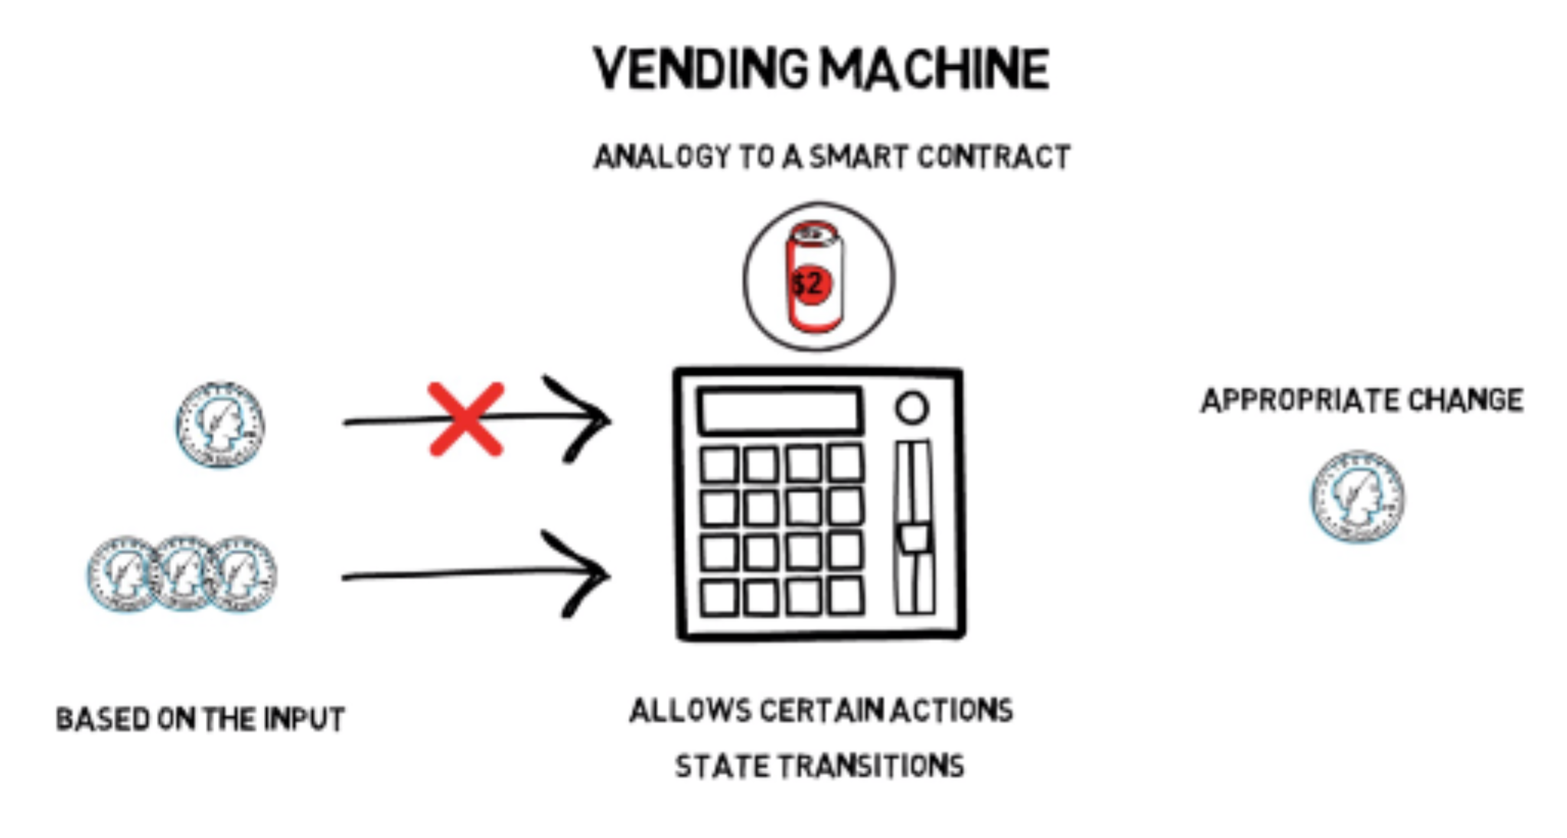
Understanding Smart Contracts
A vending machine can be considered as a simple analogy to smart contracts

Slide 62
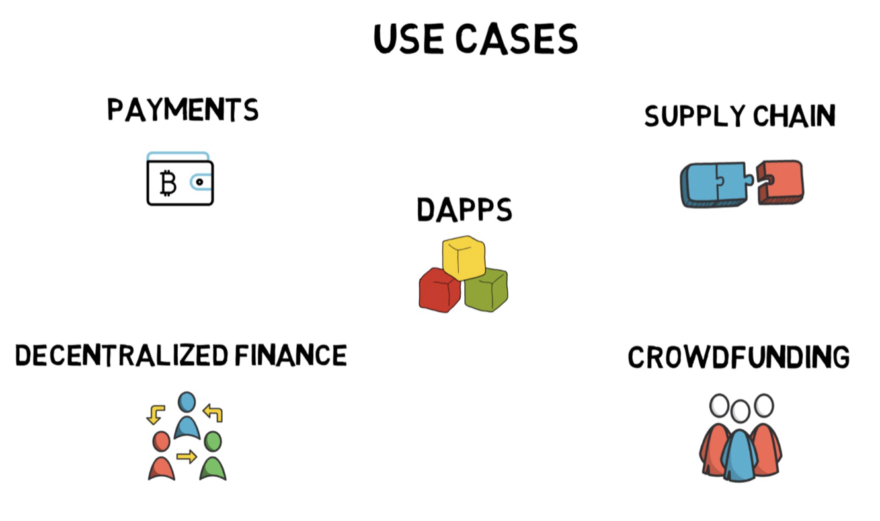
Smart Contract Applications

Slide 63
Flow chart of the Application
Smart contract
Coins/tokens are stored in this contract and released when the poll is in positive majority
Requester
Donor
Polling smart contract
Consensus
If consensus is reached then funds will be passed
other users

Slide 64
Conclusion
Smart contracts help preserve the integrity of the data and create a reliable system.
Therefore, it is possible to prevent any failure in the output. Through adopting blockchain, this model can provide anonymity, integrity, security and efﬁciency.

Slide 65
References
[1] Tatiana Cutts - Smart Contracts and Consumers (2020)(#1) https://www.academia.edu/40504701/Smart_Contracts_and_Consumers
[2] Vimal Dwivedi, Vipin Deval, Abhishek Dixit, Alex Norta - Blockchain-Based Smart-Contract Languages: A Systematic Literature Review (2019)(#1,#2) https://www.researchgate.net/publication/331198769_Blockchain-Based_Smart-Contract_Languages_A_Systematic_Literature_Review
[3] An introduction to smart contracts and their potential and inherent limitations
https://corpgov.law.harvard.edu/2018/05/26/an-introduction-to-smart-contracts-and-their-potential-and-inherent-limitations/#1
[4] Lennart Ante - Smart Contracts on the Blockchain – A Bibliometric Analysis and Review (15 Apr 2020 (revised 15 Sep 2020))(https://www.blockchainresearchlab.org/wp-content/uploads/2020/05/Smart-Contracts-on-the-Blockchain-%E2%80%93-A-Bibliometric-Analysis-and-Review-Working-Paper-V2.pdf)
[5] smart contracts (https://corporatefinanceinstitute.com/resources/knowledge/deals/smart-contracts)
[6] Ethereum Documentation (https://ethereum.org/en/developers/docs/smart-contracts/)
[7] Finematic - CODE IS LAW? Smart Contracts Explained (Ethereum, DeFi) (https://youtu.be/pWGLtjG-F5c)
[8] Substrate Documentation - https://substrate.dev/docs/en/knowledgebase
[9] A Literature Review about Smart Contracts Technology [David Nadler Prata , Humberto Xavier de Araújo , Cleórbete Santos]

Slide 66
Question & Answer

